Slide 1

Netflix Data Exploration Team 5 Python Programming

Slide 2

AGENDA
INTRODUCTION
EDA Summary With Insights
Machine Learning Techniques
Future analysis

Slide 3
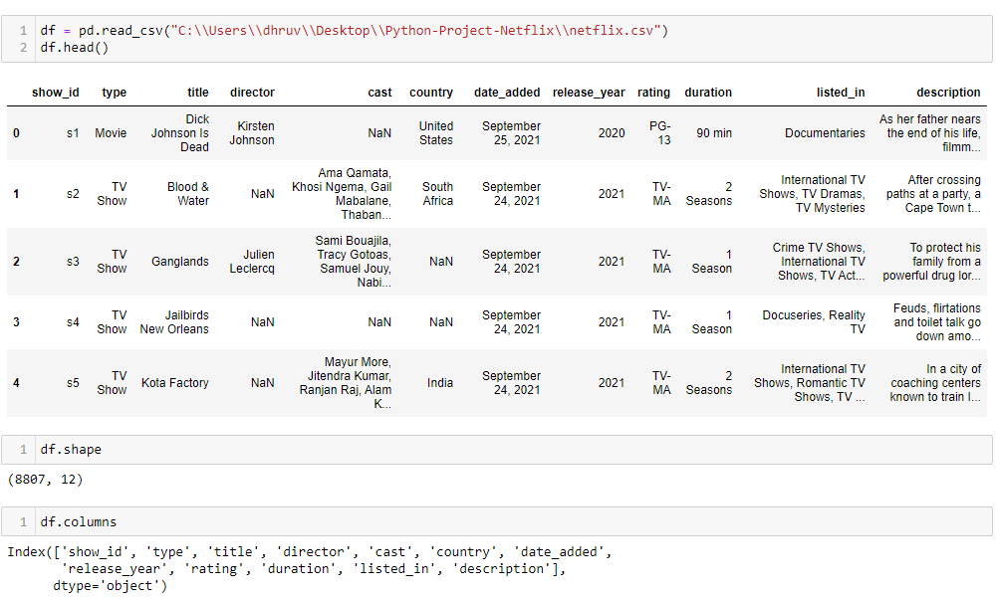
Introduction
The dataset used for analysis comprises Netflix content information, including details such as show ID, type (movie or TV show), title, director, cast, country of origin, date added to Netflix, release year, rating, duration, genres, and a brief description of the content.
The dataset encompasses a total of 8807 data points, providing a comprehensive view of Netflix's offerings
Understanding Netflix's content catalog and user preferences is crucial for various stakeholders, including content creators, marketers, and streaming platform analysts.
Analyzing this dataset can provide insights into audience preferences, content trends, and potential areas for content investment and optimization.
This analysis is particularly relevant for optimizing content recommendations, enhancing user engagement, and informing content acquisition and production strategies.

Slide 4




Data Collection
Data Preprocessing
Data Exploration
Visualization Techniques
Methodology
Obtain the dataset from relevant sources
Tasks such as handling missing values, removing duplicates, and correcting inconsistencies in the dataset
Explore the dataset using statistical summaries and descriptive analytics techniques
Utilize a variety of visualization techniques including scatter plots, bar charts, heatmaps, and pie charts to communicate insights and patterns

Slide 5
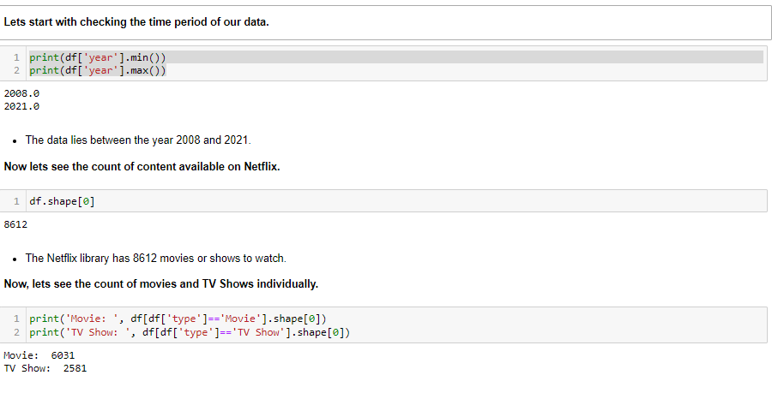
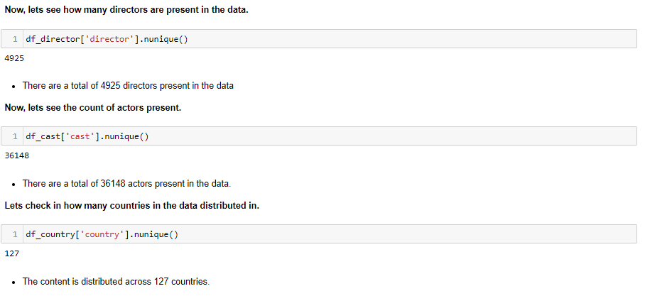
Descriptive Statistics
Content Time Period: The data spans from the year 2008 to 2021, indicating the time period covered by the Netflix dataset.
Content Count: The Netflix library comprises a total of 8612 movies or shows available for viewing.
Movies vs. TV Shows: There are 6031 movies and 2581 TV shows in the dataset, providing a breakdown of content types.
Directors: A total of 4925 directors are present in the dataset, showcasing the diversity of creative talent behind the content.
Actors: The dataset includes 36148 unique actors, reflecting the extensive pool of talent featured in Netflix productions.
Distribution by Country: The content is distributed across 127 countries, highlighting the global reach of Netflix's offerings.
This summary provides key insights into the temporal coverage, content diversity, and geographical distribution of the Netflix dataset.

Slide 6
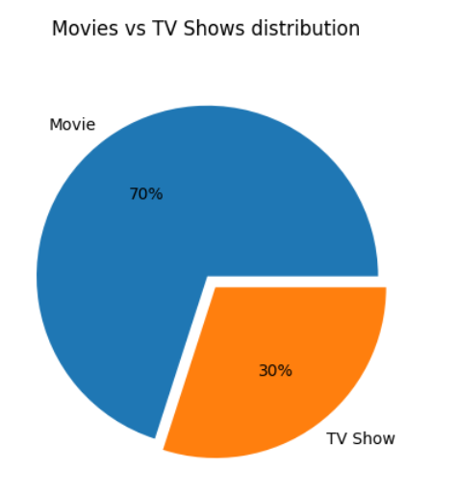
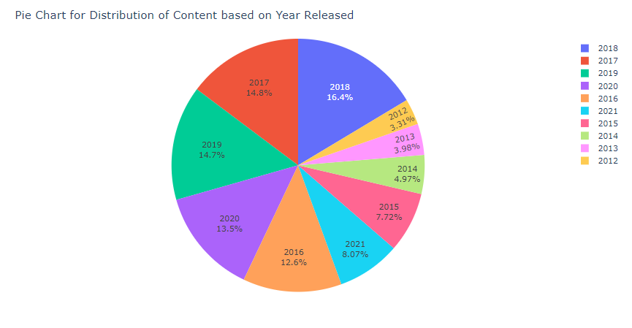
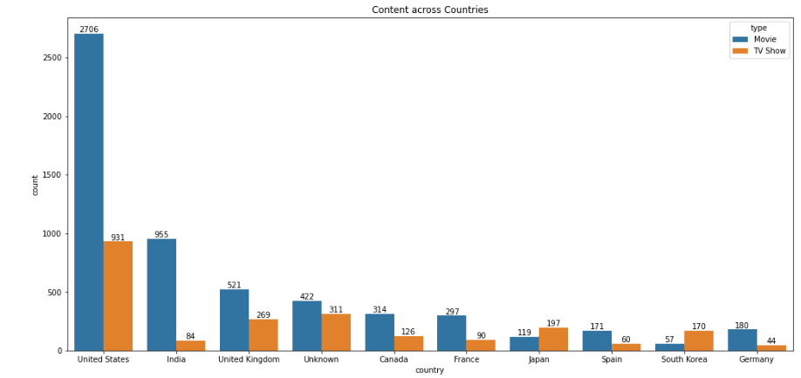
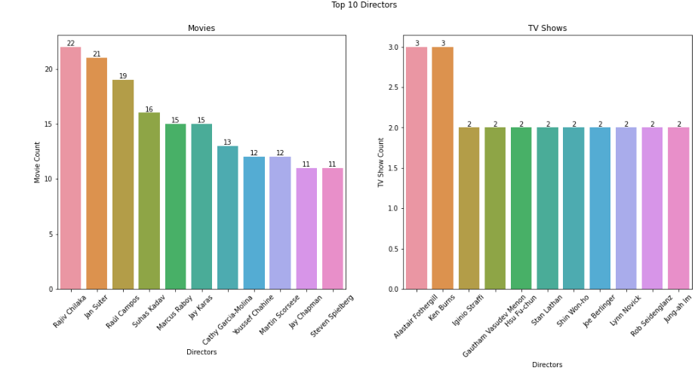
Exploratory Data Analysis
Approximately 70% of the content on Netflix consists of movies, while the remaining 30% are TV shows.
Distribution of Content on Netflix: The plot provides insights into the volume of content released each year and highlights the increasing emphasis on TV show production in recent years, particularly evident after 2018.
US has the most content for movies followed by India and UK.
TV Shows are mostly created in the US and UK.
We can also observe that all the countries have more movies than TV Shows, whereas Japan and South Korea have more TV shows than movies.
Rajiv Chilaka, Jan Suter, Raul Campos are the most active directors with 22, 21 and 19 movies,
Whereas for TV Shows all the directos have directed around 2-3 shows only.

Slide 7
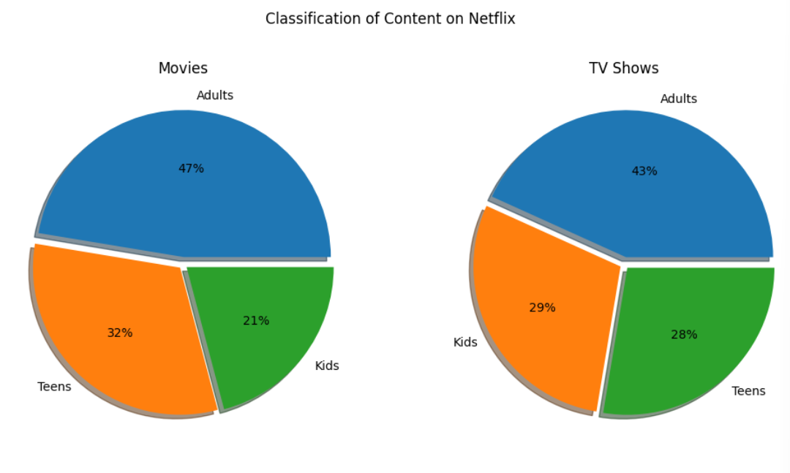
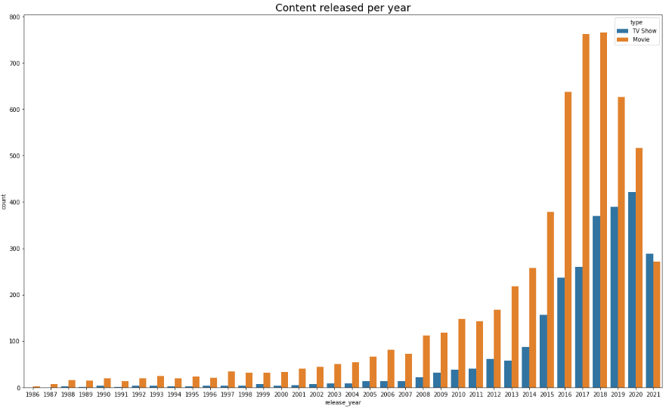
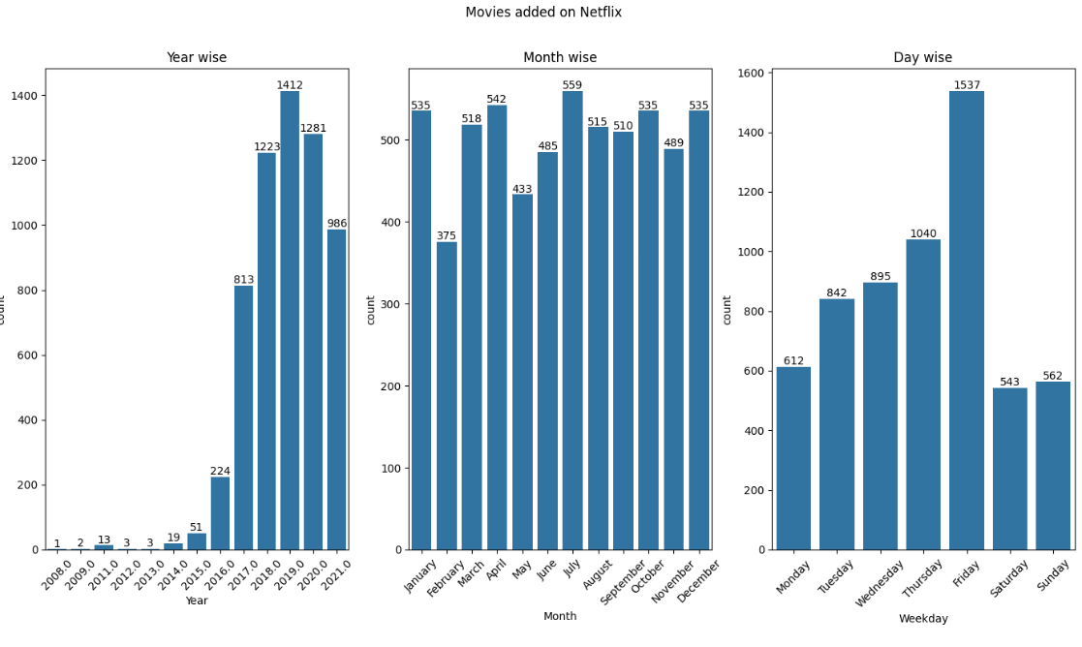
Exploratory Data Analysis
So, 2018 was the year when most of the movies were released. We can also observe that Netflix after the year 2018 is mostly concerned in producing more TV Shows. This is very clear in the year 2020 in which we see that TV Show production surmounted the Movie production. It is clear that Netflix is lately investing in producing more TV Shows than older years.
Most content on Netflix is produced for adults, followed by teens and kids. This indicates a skew towards mature audiences

Slide 8
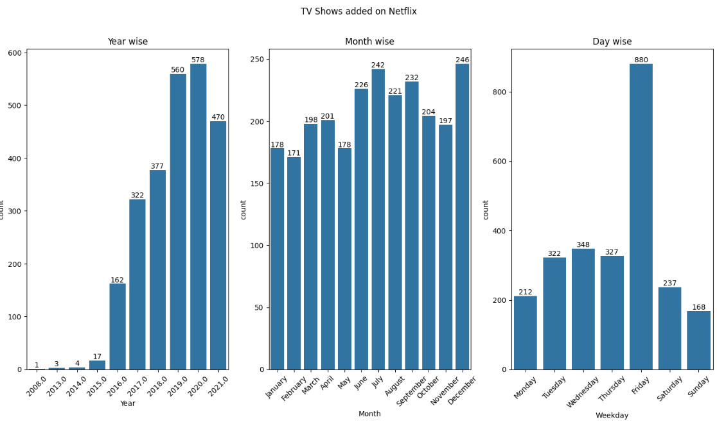
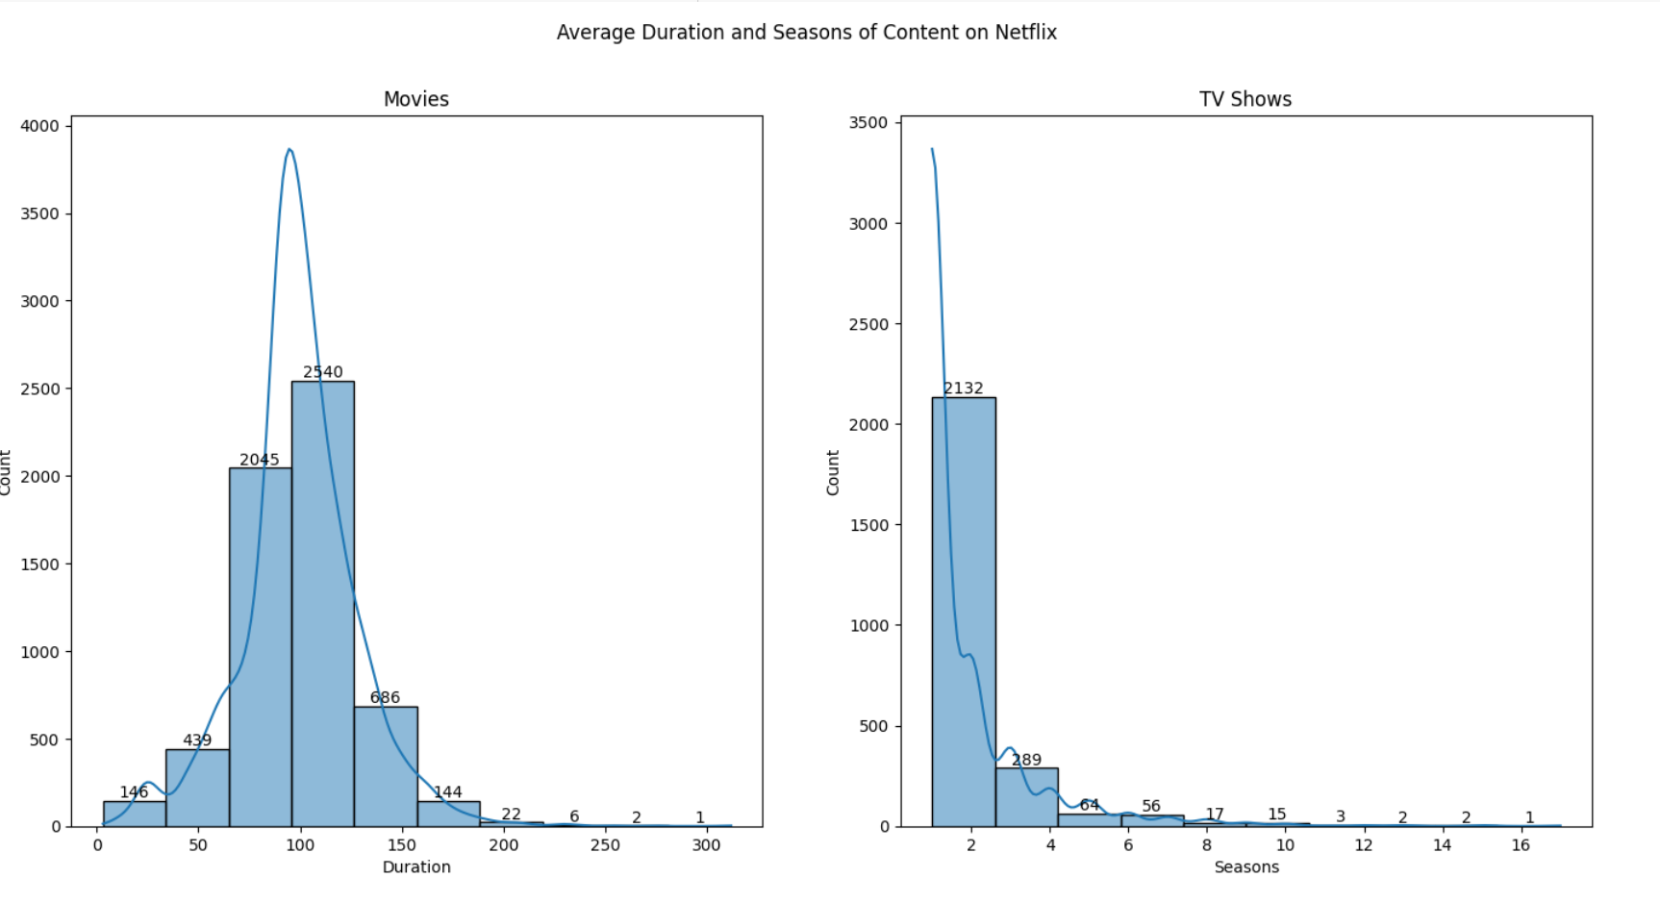
Exploratory Data Analysis
Most movies have durations between 65 and 125 minutes, while TV shows typically consist of around 2 seasons.

Slide 9
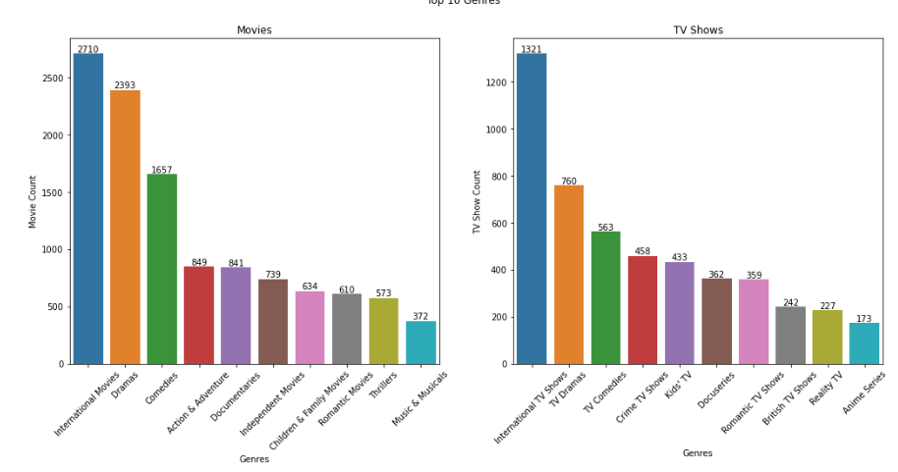
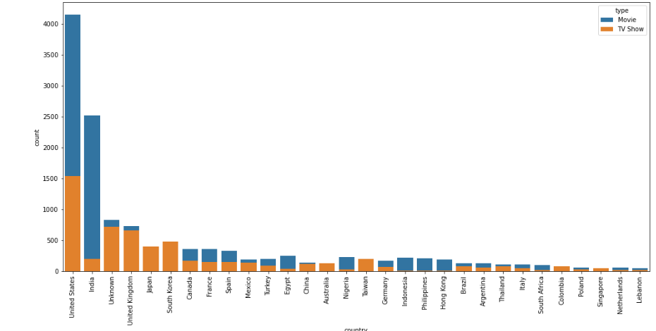
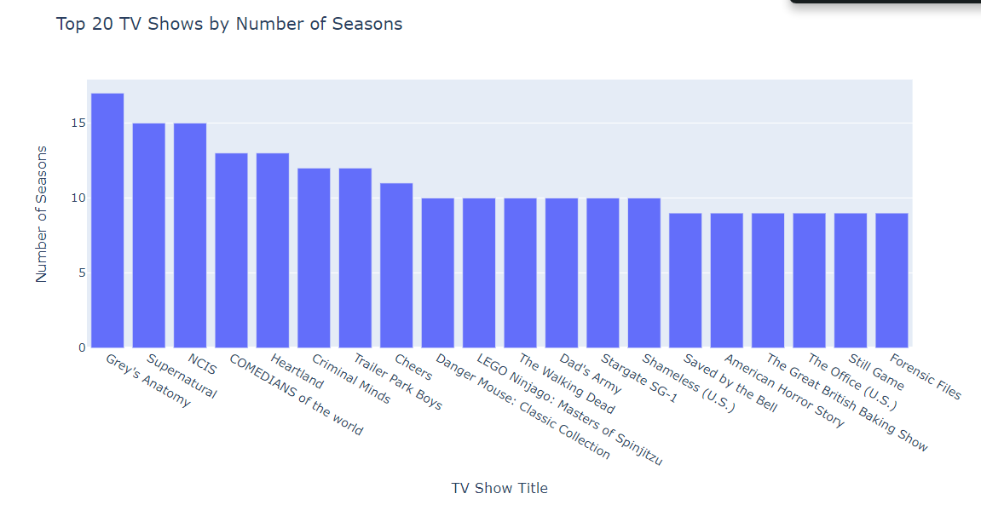
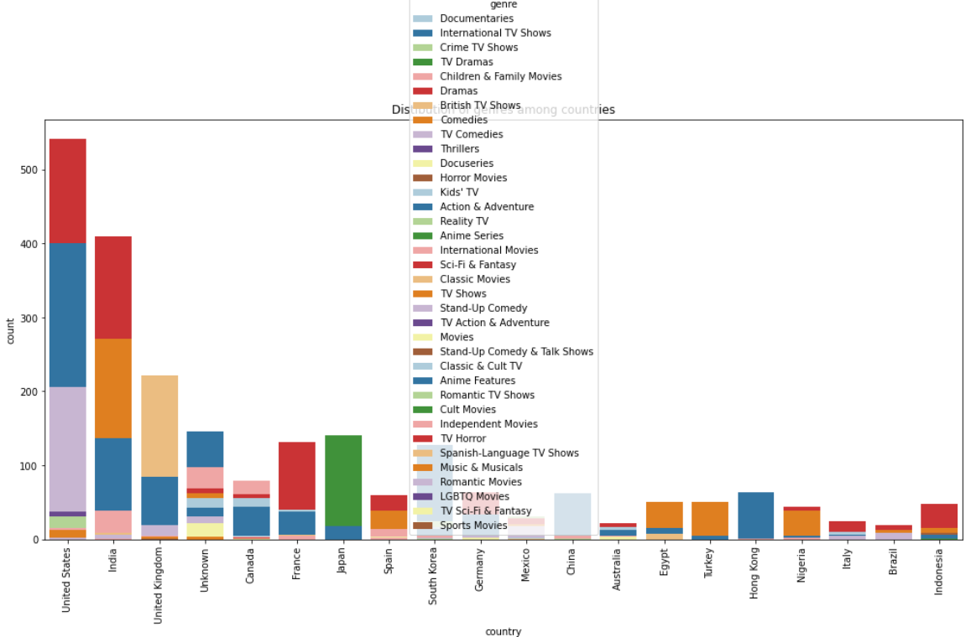
Exploratory Data Analysis
The visualization offers valuable insights into the geographic diversity of Netflix's content library, highlighting countries with a significant presence in terms of content production. It also reveals patterns in content distribution across different regions, informing localization and regional content strategies.
From the above graph, it is inferred that most of the content fall under International followed by Drama and Comedy genre
A bar chart showcases the top 20 TV shows on Netflix based on the number of seasons. Each bar represents a TV show, with the length of the bar indicating the number of seasons the show has. This visualization provides insights into the most prolific TV shows available on Netflix in terms of the number of seasons produced.
Rajiv Chilaka, Jan Suter, Raul Campos are the most active directors with 22, 21 and 19 movies,
Whereas for TV Shows all the directos have directed around 2-3 shows only.

Slide 10
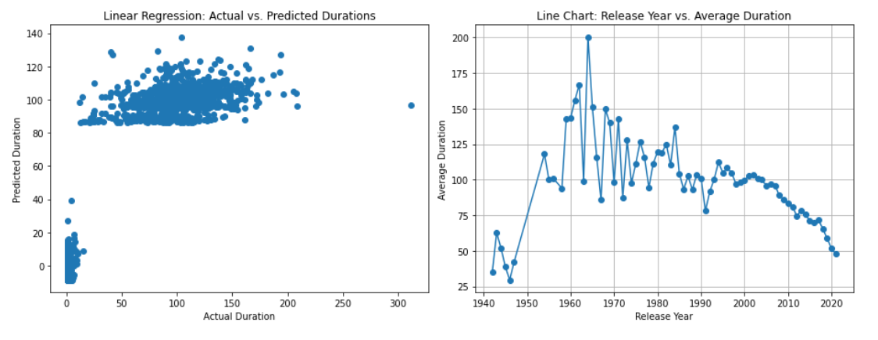
Machine Learning (Linear Regression)
Model Training and Evaluation: Utilizing the sklearn library, we applied linear regression to predict the duration of Netflix content based on features such as release year, content type (movie or TV show), and content rating. The dataset was split into training and testing sets to evaluate model performance.
Model Performance: The trained linear regression model achieved a Mean Absolute Error (MAE) of approximately 15.46 when predicting content durations. This metric quantifies the average difference between the actual and predicted durations, providing insight into the model's accuracy.
Actual vs. Predicted Durations: A scatter plot illustrates the comparison between actual and predicted durations of Netflix content. Despite some variance, the plot demonstrates the model's ability to capture trends and patterns in content durations.
Release Year vs. Average Duration: A line chart depicts the relationship between release year and the average duration of Netflix content. This visualization reveals trends in content duration over time, offering insights into evolving viewer preferences and content production strategies.
Implications and Insights: The linear regression analysis enables us to understand the factors influencing content duration and predict durations for future Netflix releases. This insight can inform content planning, scheduling, and audience engagement strategies, ultimately enhancing the viewer experience.

Slide 11
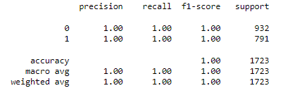
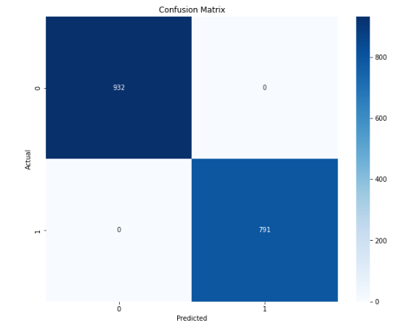
Machine Learning (Logistic Regression)
Content: Data Preprocessing: Categorical variables such as content type (movie or TV show) and content rating were encoded using LabelEncoder to prepare the data for logistic regression modeling.
Model Training and Evaluation: The dataset was split into training and testing sets, and a logistic regression model was trained using the sklearn library. The model's performance was evaluated using classification report metrics, including precision, recall, and F1-score.
Classification Report: The classification report provides a detailed evaluation of the model's performance, including precision, recall, and F1-score for each class (movie or TV show). The report indicates high accuracy and performance across both classes, with precision, recall, and F1-score values all close to 1.
Confusion Matrix: A confusion matrix visualization further illustrates the performance of the logistic regression model by comparing predicted versus actual classifications. The heatmap depicts the number of correct and incorrect predictions for each class, providing insights into the model's ability to classify Netflix content accurately.
Implications and Insights: The logistic regression analysis enables accurate classification of Netflix content based on features such as release year and content rating. This insight can inform content recommendation systems, personalized user experiences, and content categorization strategies on the Netflix platform.

Slide 12
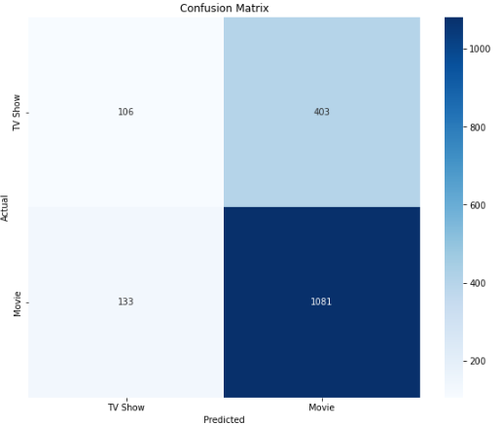
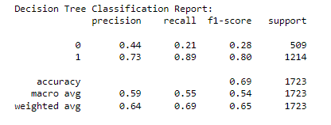
Machine Learning (Decision Tree)
Data Preprocessing: Categorical variables such as content type (movie or TV show) and content rating were encoded using LabelEncoder to prepare the data for decision tree classification.
Model Training and Evaluation: The dataset was split into training and testing sets, and a decision tree classifier was trained using the sklearn library. The model's performance was evaluated using a classification report, which includes precision, recall, and F1-score metrics.
Decision Tree Classification Report: The classification report provides insights into the decision tree model's performance, indicating precision, recall, and F1-score for each class (TV show or movie). The report highlights the model's ability to predict movie classification with higher accuracy compared to TV shows.
Decision Tree Visualization: A visual representation of the decision tree model is depicted, illustrating the decision-making process based on features such as release year and content rating. The tree structure provides interpretability and insights into the factors influencing content classification.
Confusion Matrix: A confusion matrix visualization further illustrates the performance of the decision tree classifier by comparing predicted versus actual classifications. The heatmap displays the number of correct and incorrect predictions for each class, facilitating a deeper understanding of classification accuracy.
Implications and Insights: Decision tree classification offers a transparent and interpretable approach to categorizing Netflix content based on relevant features. This insight can inform content recommendation algorithms, content categorization strategies, and personalized user experiences on the Netflix platform.

Slide 13
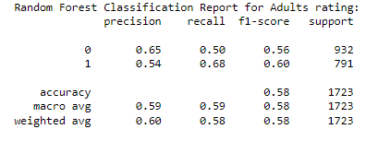
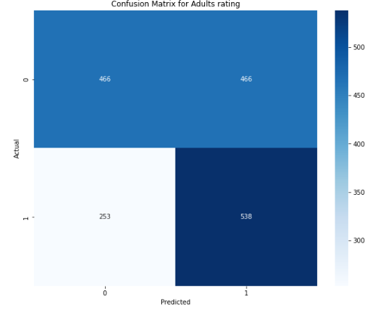
Machine Learning (Random forest)
Data Preparation: The dataset was preprocessed to encode categorical variables and select relevant features for predicting adults rating based on features such as release year and content type (movie or TV show).
Model Training and Evaluation: The data was split into training and testing sets, and a random forest classifier was trained using the sklearn library with 100 estimators. The model's performance was evaluated using a classification report, which includes precision, recall, and F1-score metrics.
Random Forest Classification Report: The classification report provides insights into the random forest model's performance in predicting adults rating, indicating precision, recall, and F1-score for each class (adults or not adults). The report highlights the model's moderate accuracy in predicting adults rating based on the provided features.
Confusion Matrix: A confusion matrix visualization further illustrates the performance of the random forest classifier by comparing predicted versus actual classifications for adults rating. The heatmap displays the number of correct and incorrect predictions for each class, providing insights into the model's classification accuracy.
Implications and Insights: Random forest classification offers a robust and scalable approach to predicting adults rating based on features extracted from Netflix content metadata. This insight can inform content categorization strategies, parental controls, and content recommendation systems on the Netflix platform.

Slide 14
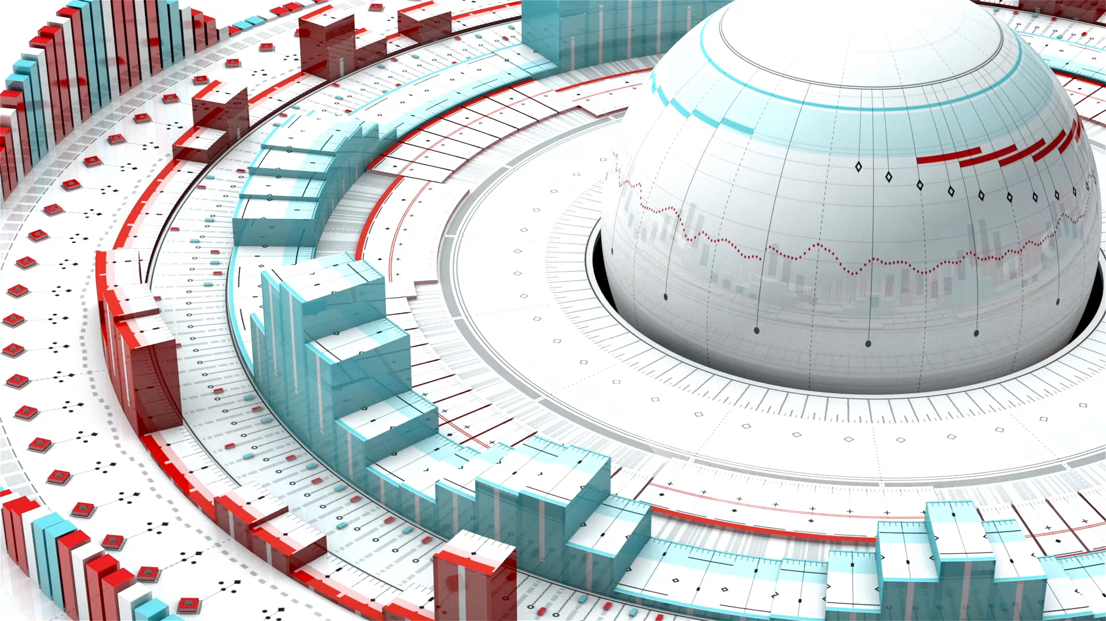
Future analysis
Exploring Additional Features: Future analysis could involve exploring additional features such as director, cast, genre, and viewer ratings to gain deeper insights into content characteristics and viewer preferences. Incorporating these features into predictive models could enhance content recommendation algorithms and personalize user experiences on the Netflix platform.
Advanced Machine Learning Techniques: Leveraging advanced machine learning techniques such as natural language processing (NLP) for analyzing textual descriptions, deep learning for image recognition, and collaborative filtering for user-based recommendations can further enhance the sophistication and accuracy of content recommendation systems. Investing in cutting-edge technologies and methodologies can position Netflix as a leader in the entertainment industry.
Enhancing Model Performance: Continuous efforts to enhance model performance through hyperparameter tuning, feature engineering, and ensemble learning methods can lead to more accurate predictions and actionable insights. Collaborative research and development initiatives with academia and industry partners can drive innovation and push the boundaries of predictive analytics in the streaming media domain.

Slide 15

THANK YOU
Dhruv Chamaria Nitant Bhagat Harsh Modi

